Slide 1
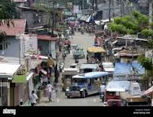
POPULATION CHANGES IN BARANGAY

Slide 2
INPUT
OUTPUT
Prompts the user to input the population numbers of each barangay for the year 2024
Input() collect the number as a string.andint() convert it into an integer
2024 total:5900
2025 total:****
Total sum population:****

Slide 3
Why is useful?
because it compares the population of five barangays between 2024 and 2025. It shows if the population increased or decreased, helping identify trends. This information is important for planning services like schools, healthcare, and transportation. In short, it helps support better decisions based on population changes.

